Slide 1


Gustavo Gattass Ayub
Sr. Product Manager – Data &AI
Microsoft Brasil

Slide 2
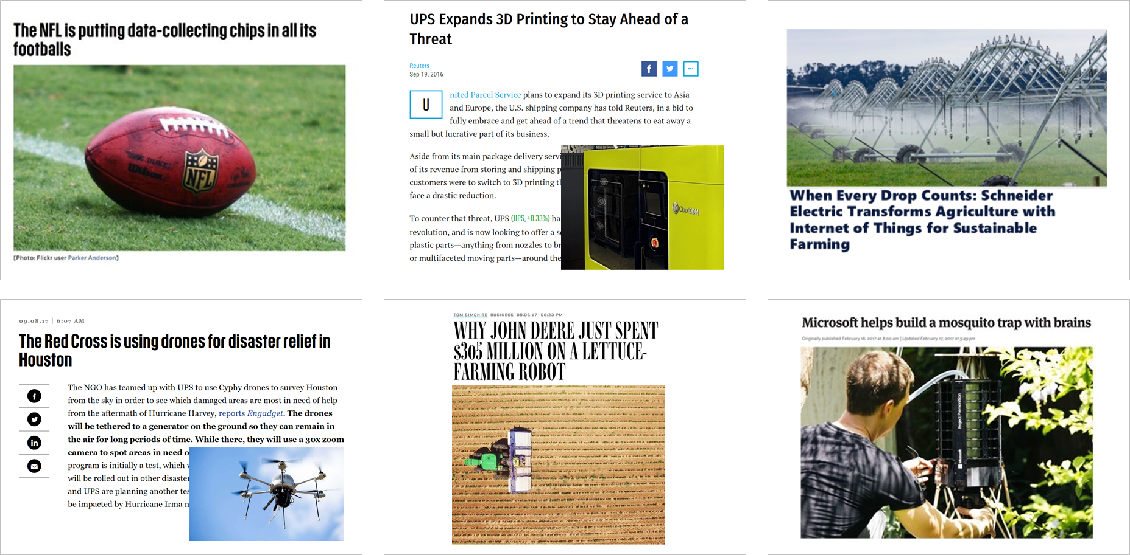
The modern world runs on code

Slide 4
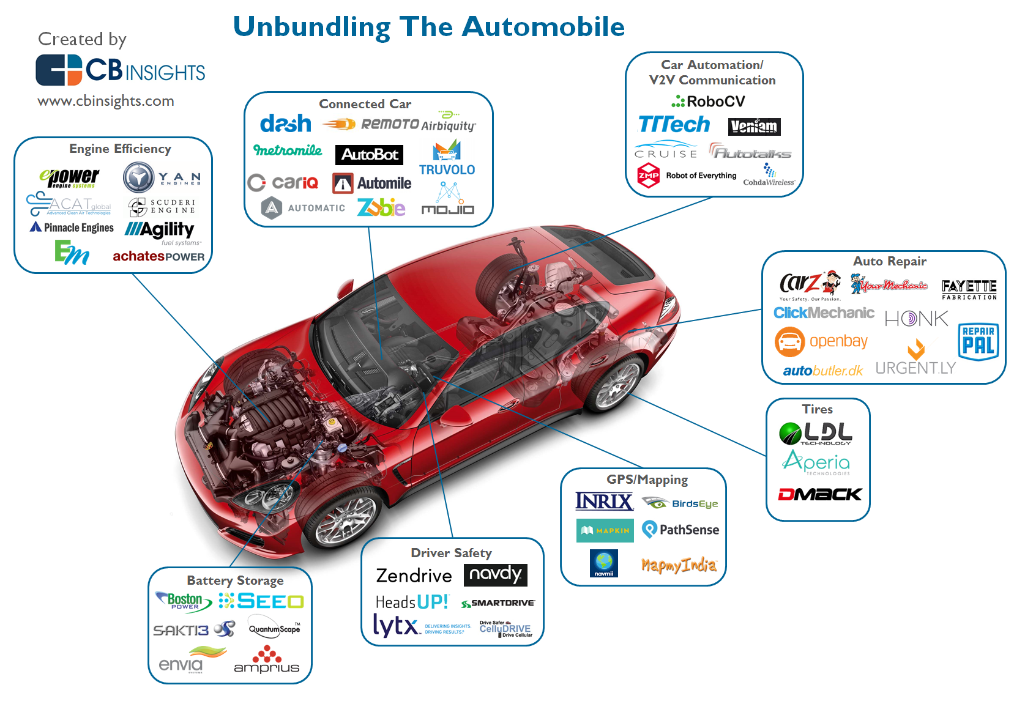

Slide 5
Customers
Deeper relationships
Operations
More efficient ops
Customer signal
Operational data
The digital feedback loop
Data + intelligence
Employee input
Product telemetry
1
Data: Capture digital signal across business
Mo
2
Insight: Connect and synthesize data
Better products
Employees
re effective employees
Products
3
Action: Improve business outcomes
Notes:
The digital feedback loop.
The DFL takes the signal from new software-infused sources, brings it together, and uses the insights to drive continuous innovation.
We’ve identified this key to success by studying these patterns and disruptions across industries and looking inward at our own business.
To make this happen for your company, you need a partner to ease your company through this challenging evolution successfully.
MS offers partnership and guidance through every step of this process, because we understand the challenges you face. Not long ago, we faced them, too.

Slide 6

1
Data: Capture digital signal from across business
Consumer Reports review indicate braking issue with Model 3
Vehicle telemetry shows brake performance across fleet
The digital feedback loop
Customer signal
Product telemetry
2
Insight: Connect and synthesize data
Car telemetry for suspect cars analyzed to understand issue
Tesla identifies fix to improve stopping distance
Deeper relationships
Better products
Data + intelligence
Engage customers
Transform products
3
Action: Improve business outcomes
Car braking software updated over-the-air to fix issue
Tesla closes the loop with consumer reports and review is updated
Notes:
Tesla drives important change using the digital feedback loop.
It captures important driving information from its cars and uses that to drive data-based innovation.
Through social media, free-trial marketing pilots, and telemetry tracking, Tesla makes decisions with a customer-focused mindset. They use customer complaints to fuel new ideas and improvements.
Where once German car giants once thought of themselves as untouchable, they can’t laugh off Tesla anymore. Through the DFL, Tesla now steers the vehicle revolution.
But in terms of the traditional successful business model, Tesla is missing the mark. (Manufacturing Model 3)

Slide 7
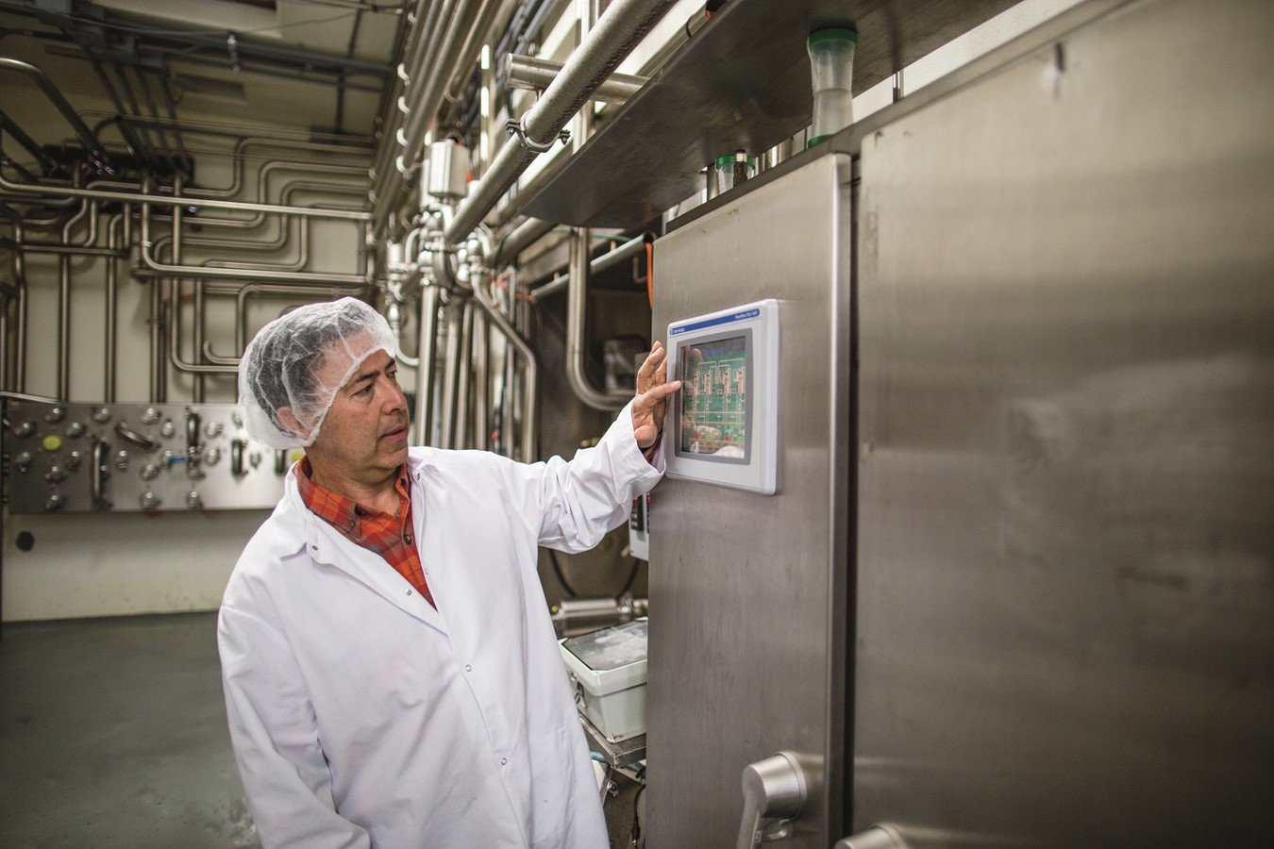
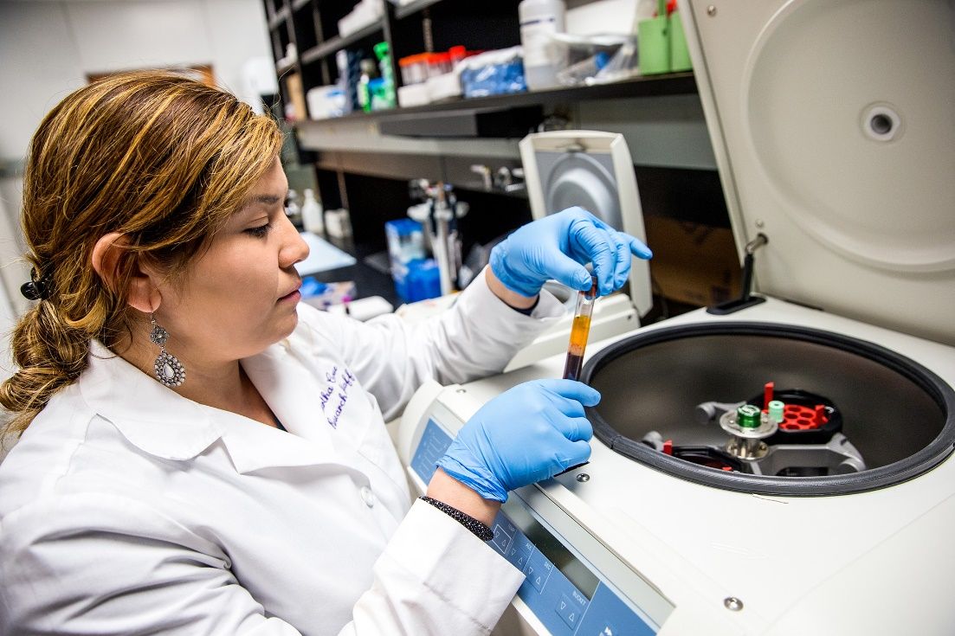

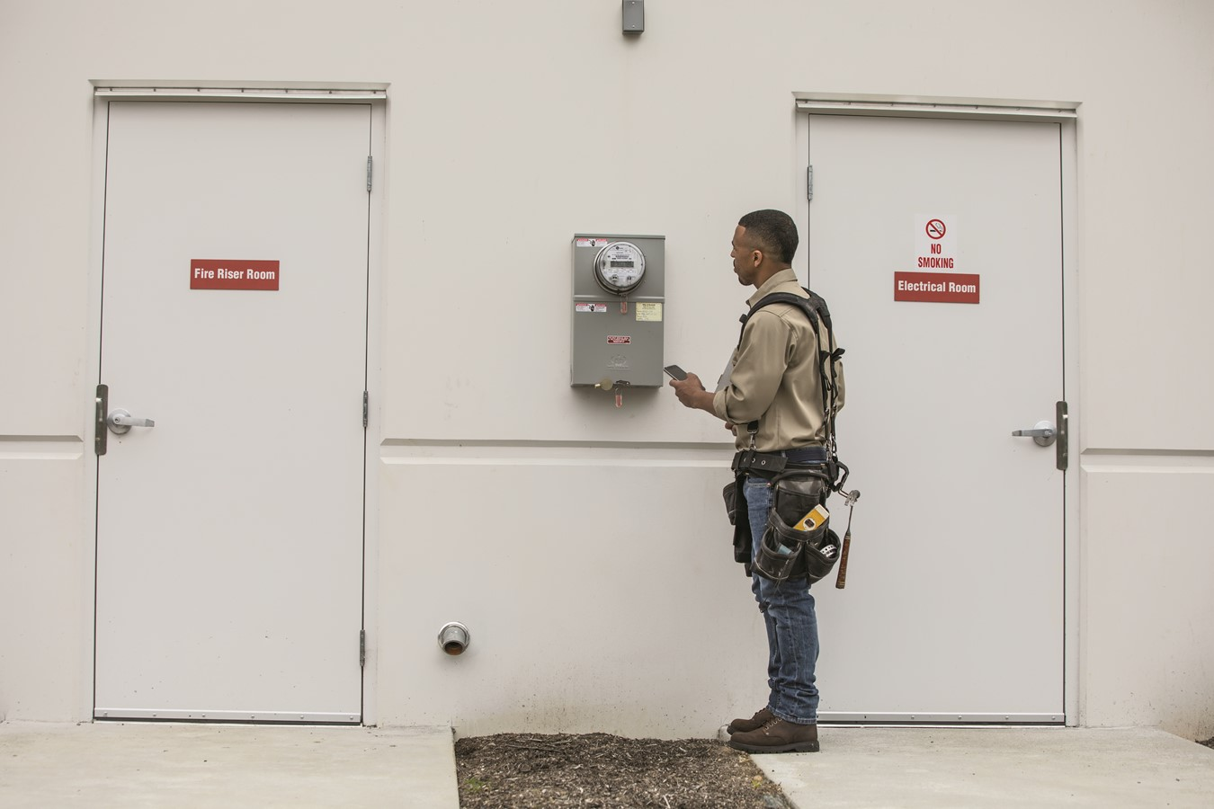
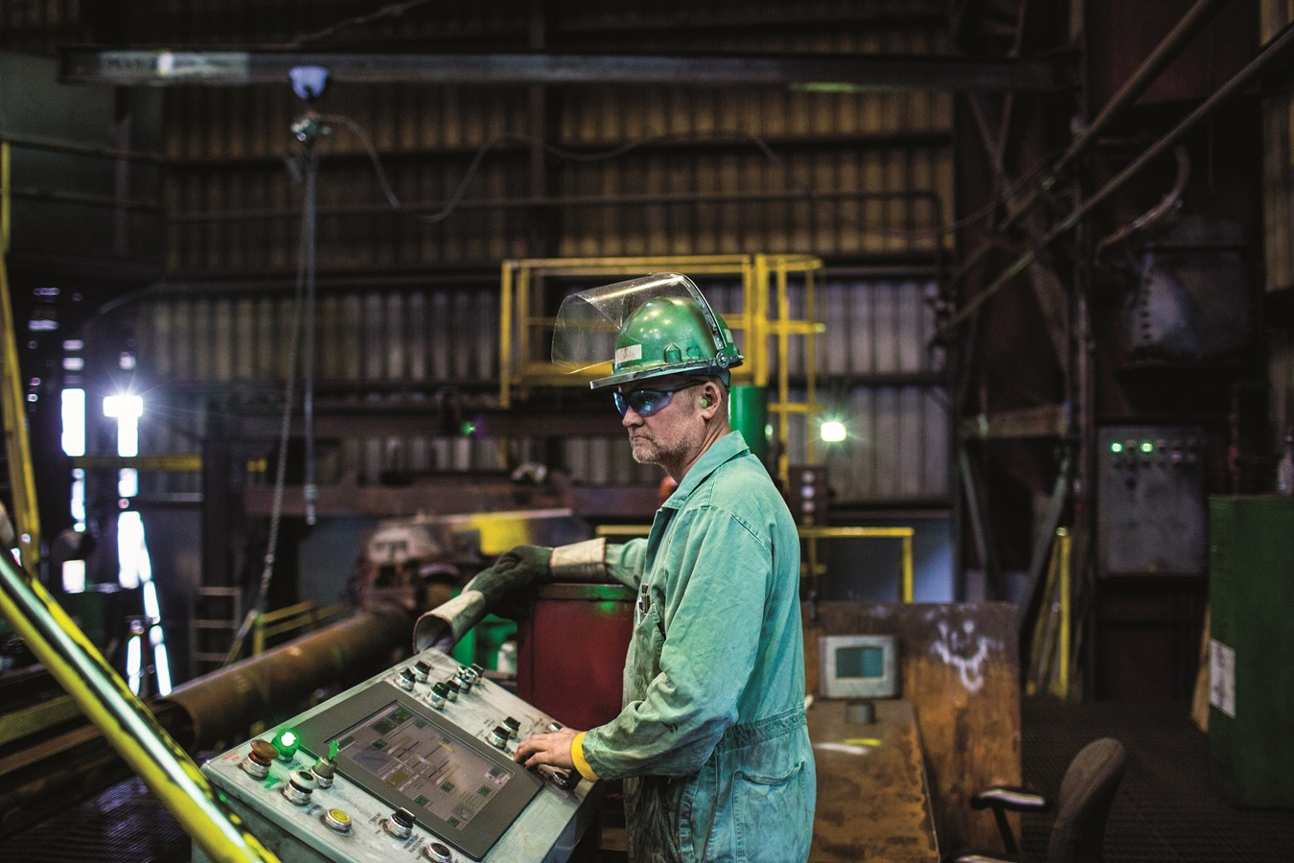
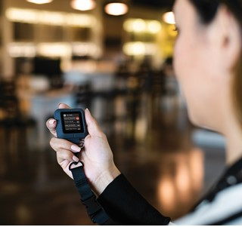

Role of software in Automotive
Role of SW in Auto Developers as a % of Overall Headcount
Average American Car Company
Notes:
Even in the automotive industry, you can see the role of software where developers make up 1% of the overall headcount in the average America Car Company.
At Tesla, 6.6% of overall headcount is comprised of developer roles.

Slide 8
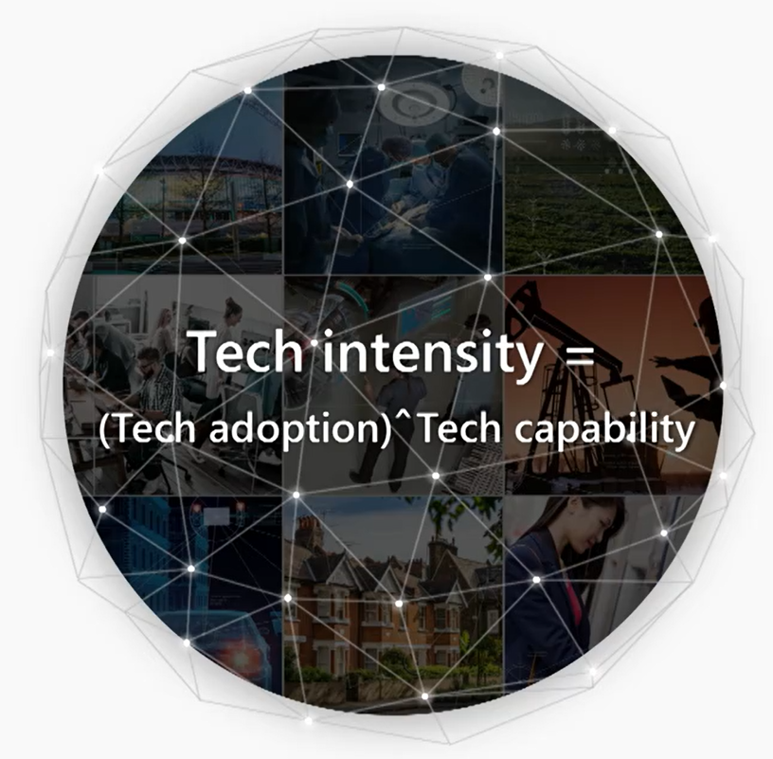

Slide 9
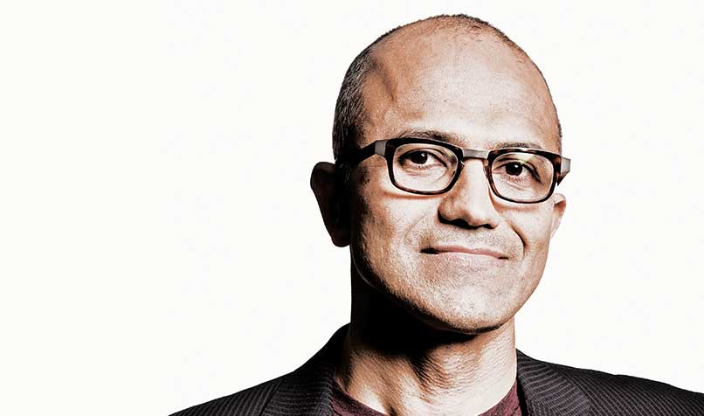
Your opportunity
Every company is a software company. You have to start thinking and operating like a digital company.
It’s no longer just about procuring one solution and deploying it. It’s not about one simple software solution.
It’s really about you yourself thinking of your own future as a digital company.
Satya Nadella

Slide 10
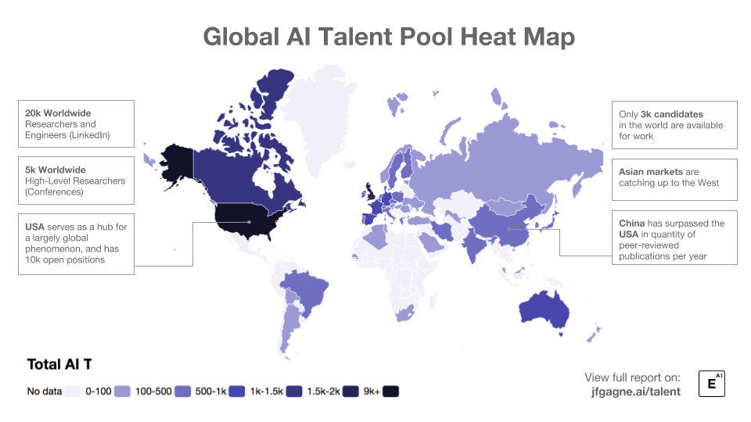

Slide 11
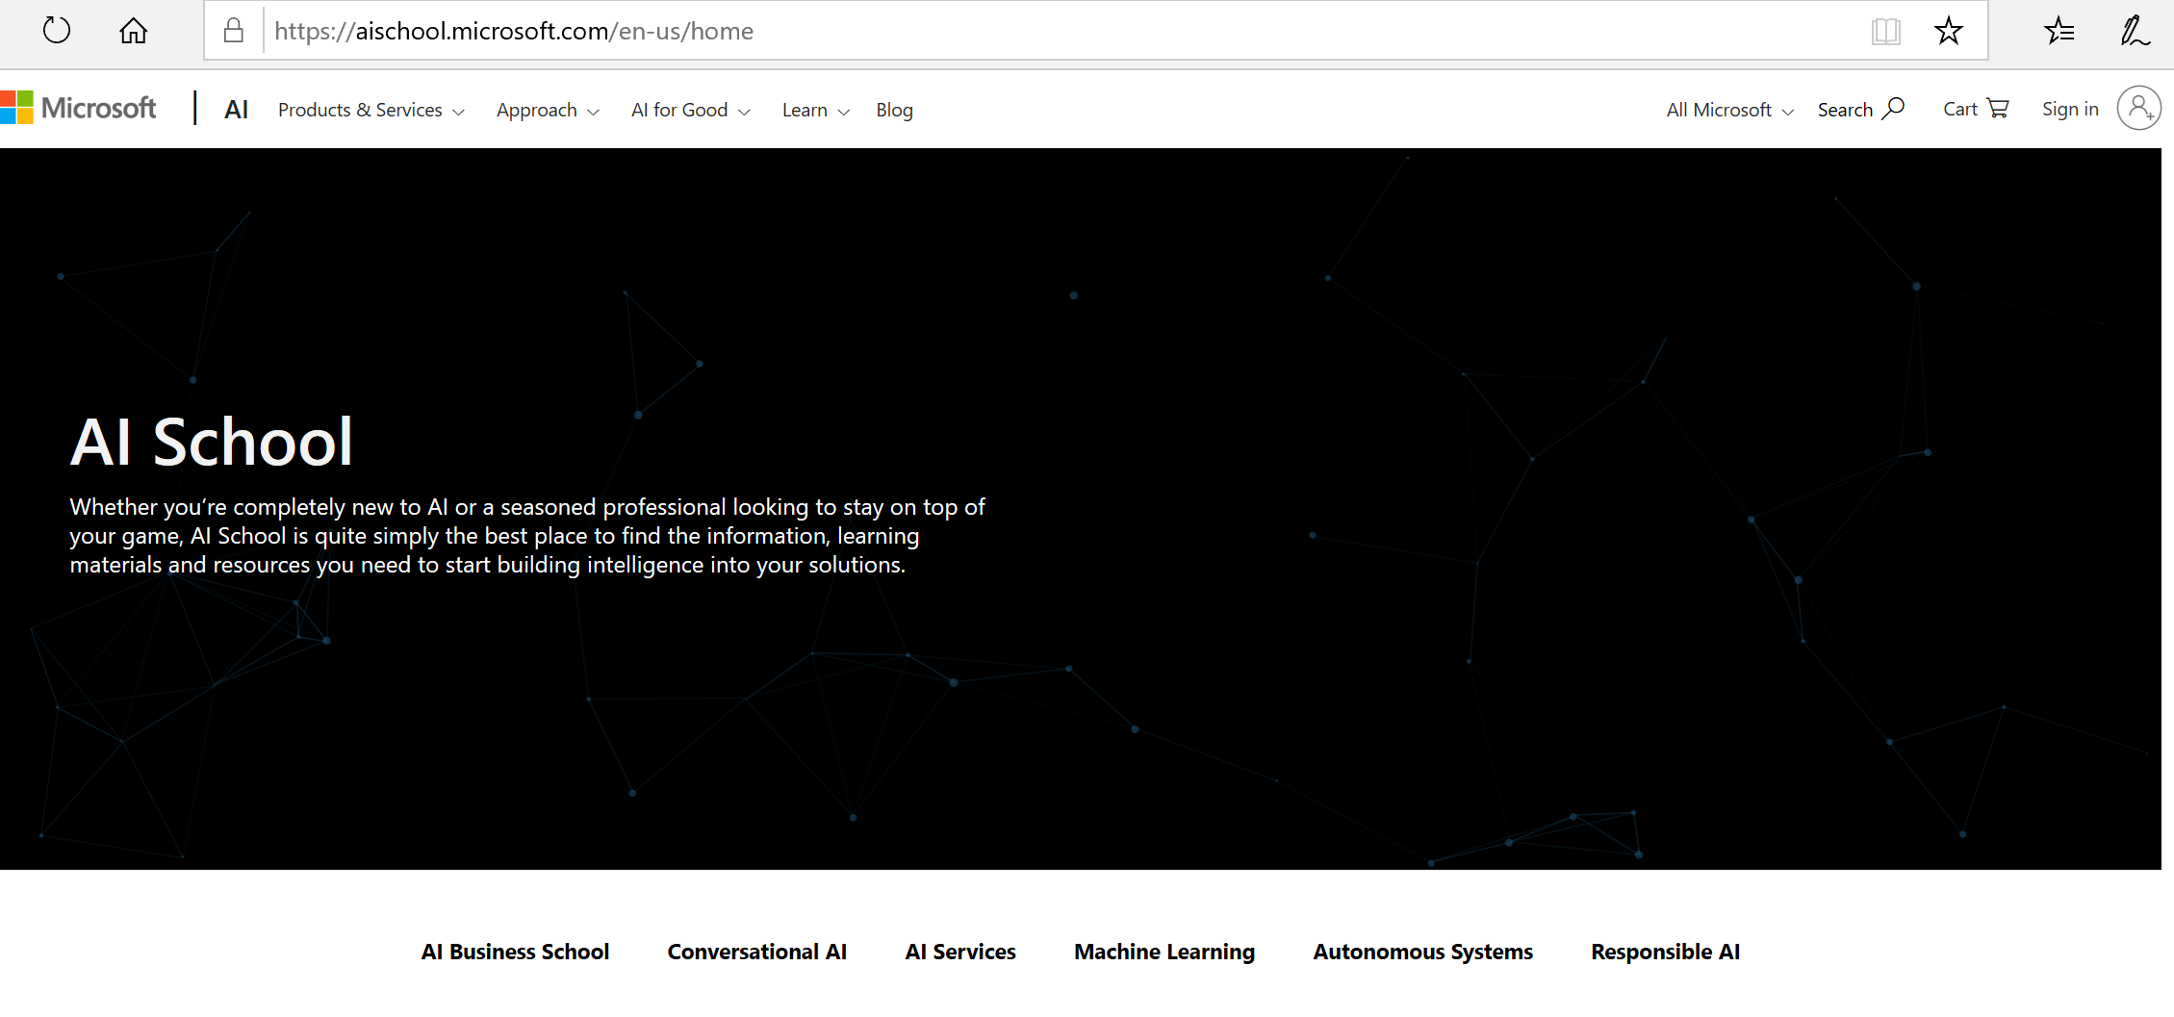

Slide 12
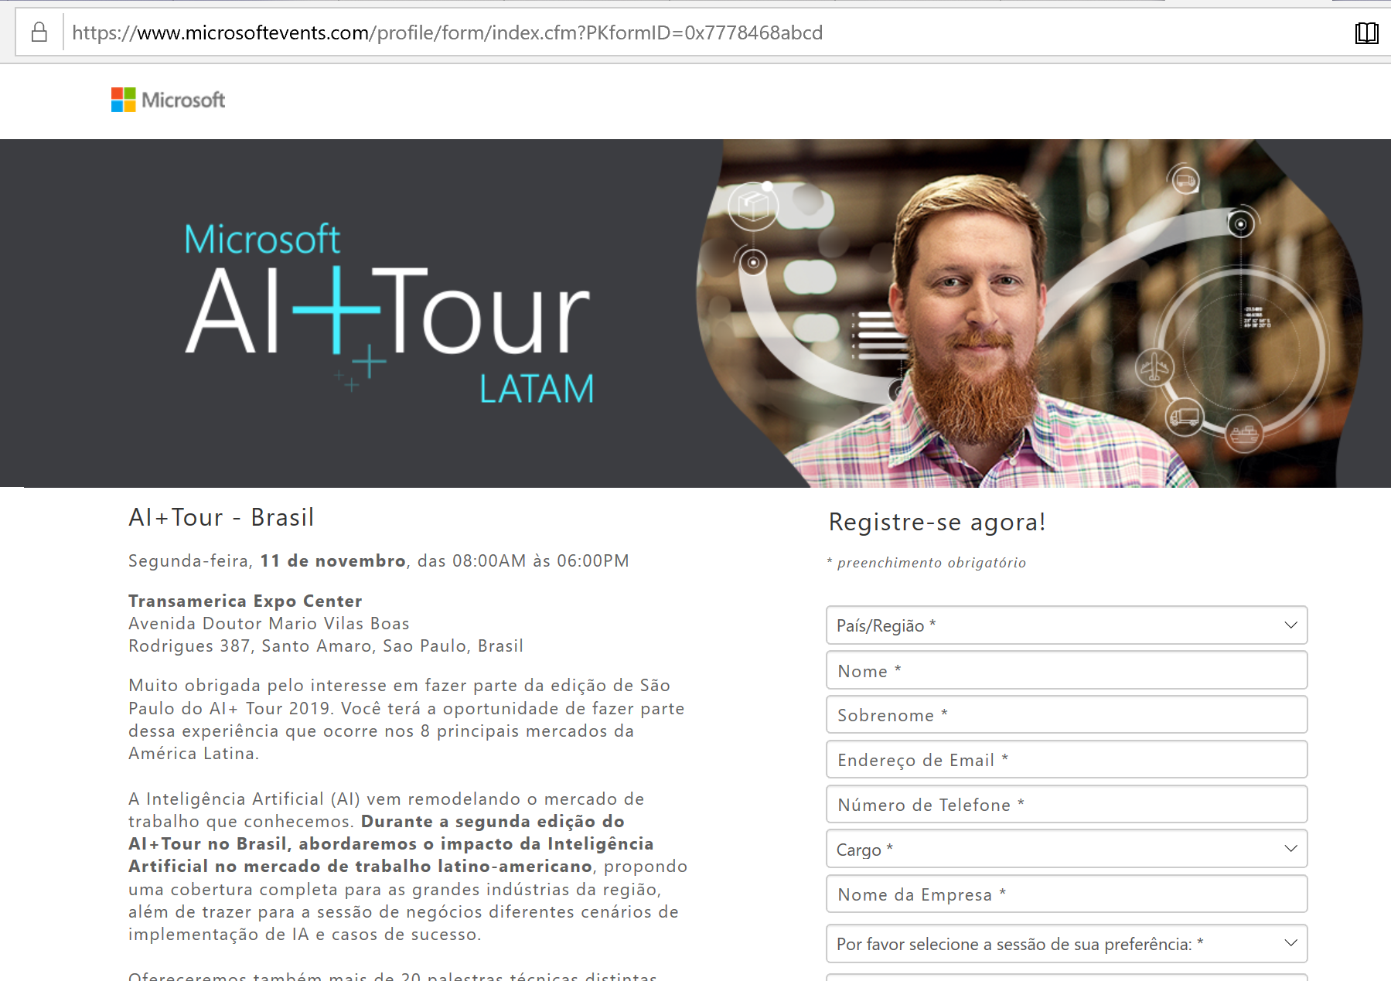
http://aka.ms/aitourbr2019

Slide 13
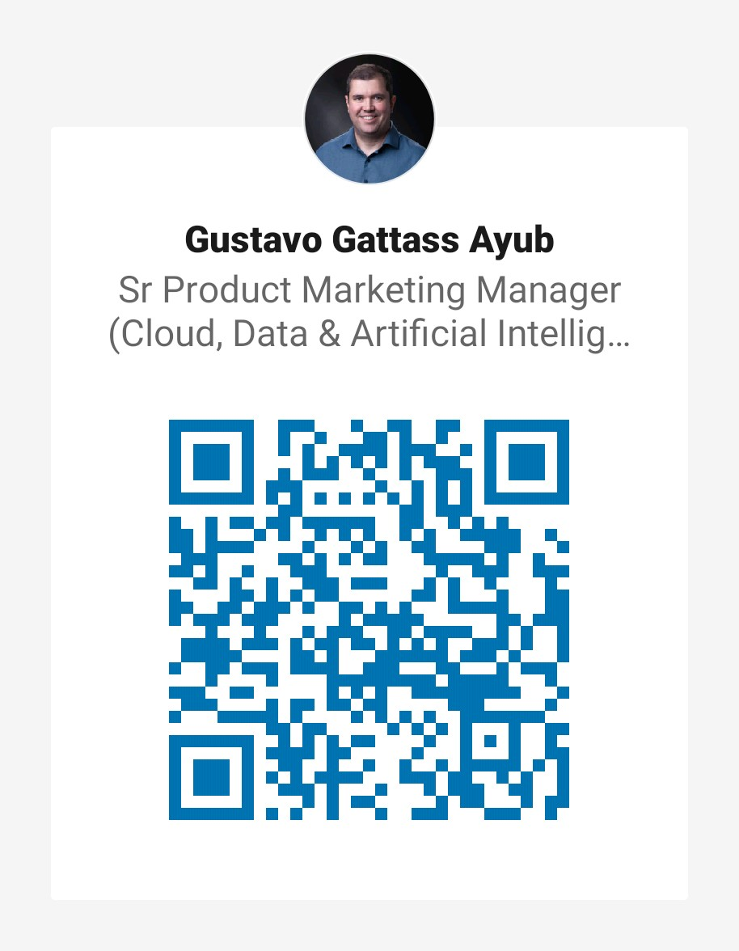
Gustavo Gattass Ayub www.linkedin.com/in/ggattass
http://aka.ms/aitourbr2019

